Slide 1
VTap
Intern: Balan Giorgiana-Lavinia
Mentor: Tudor cornea

Slide 2
Objectives
The use case of the tool: testing the functionality of a network
Very fast traffic monitoring of TCP / UDP / ICMP flows
Real-time measurements
Measurements:
Throughput
Packet filtering
User friendly UI
Jitter
Sequence errors

Slide 3



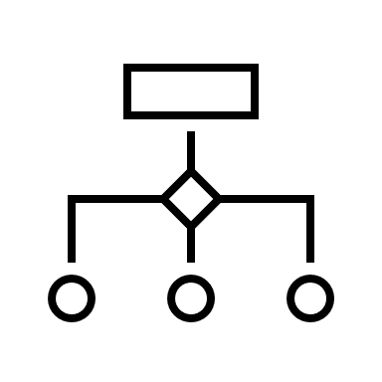
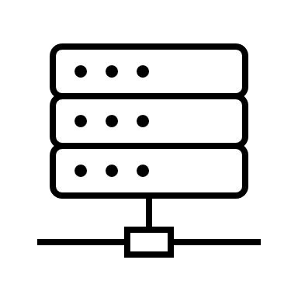
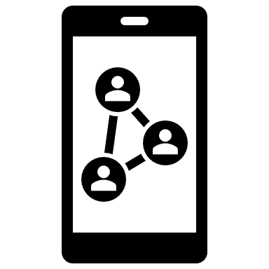



Architectural Diagram
Endpoints
Endpoint
VTap VM

Slide 4

Motivation – Used Technologies
eBPF
BCC framework
New technology
Direct communication with Linux kernel
Very fast processing speed
High Flexibility
Prometheus
Open Source
Gathering information from monitoring tool server
Efficient Storage
Alerting System

Slide 5


Motivation – Used Technologies
Grafana
Open Source
Great visualization
Easy to connect with Prometheus
Docker
Host Prometheus and Grafana servers
Easy configuration

Slide 6
Features / measurements
Throughput / goodput
Formula: the average bytes in a specific amount of time given as parameter
(Default is 1 second)
Throughput → payload + (layer 2 + layer 3 + layer 4) headers
Goodput → only the layer 4 payload
The measurement is displayed in Bytes / Second (or Bits / Second if
“–b” parameter is given)

Slide 7
Features / measurements
jitter
Average packet interarrival time
+
Standard deviation
Jitter > 2 seconds probably flow stopped

Slide 8
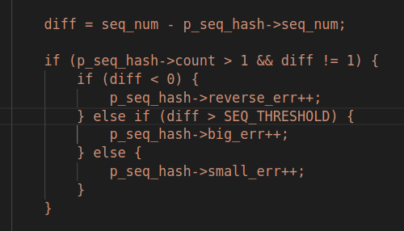
Features / measurements
Packet drops – sequence errors
Reverse errors
Small errors
Big errors
+
Total sequence errors
diff = current_sequence_number – previous_sequence_number

Slide 9





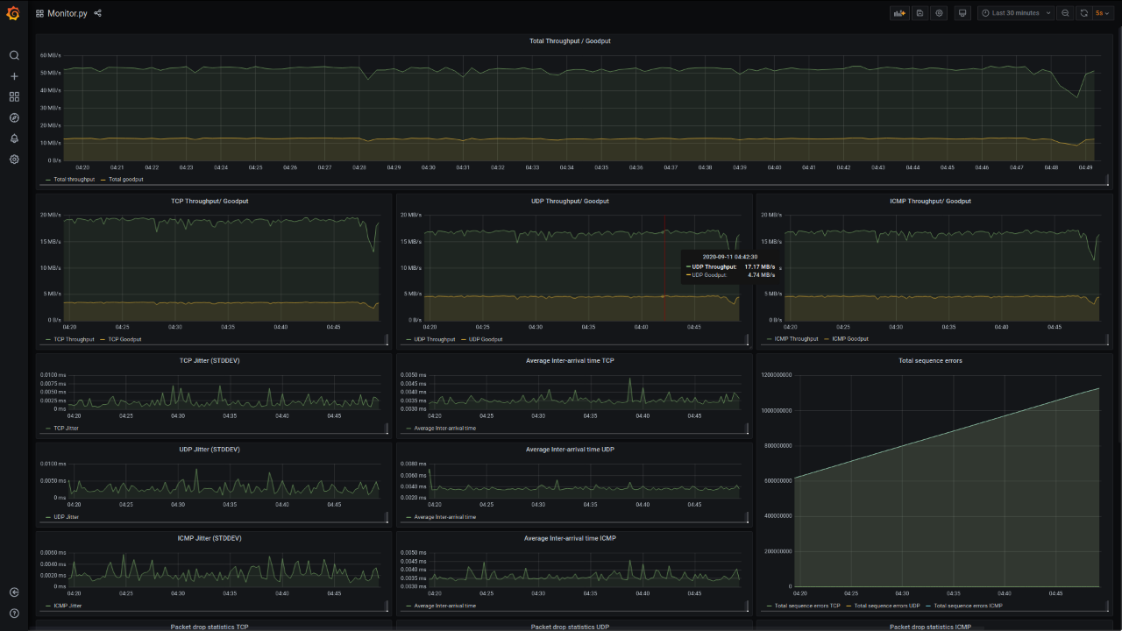
Prometheus + Grafana integration
PORT: 9090
PORT: 3000
DB
Scraping
VTap Monitor Server
PORT: 8080

Slide 10
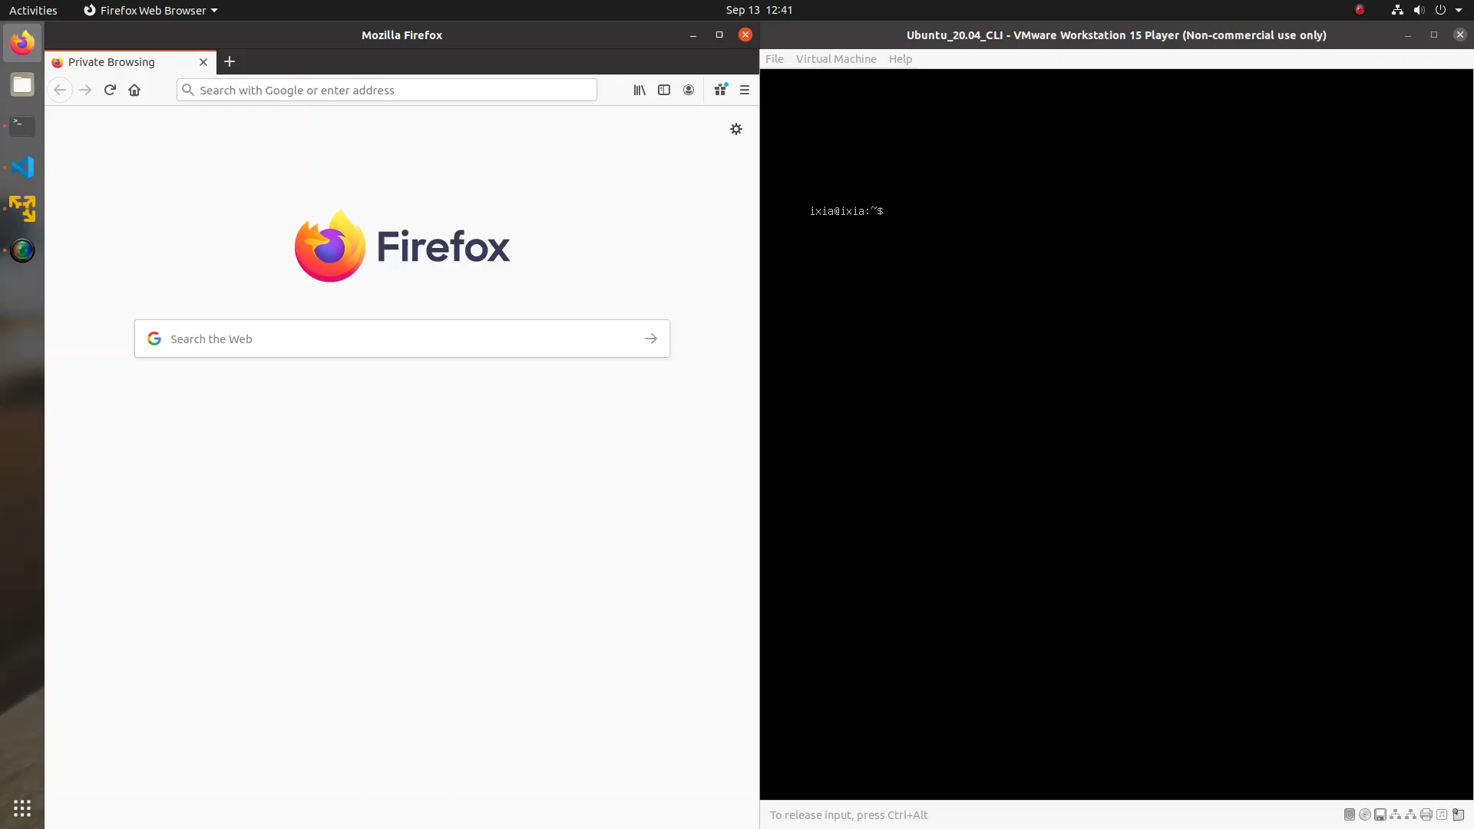
DEMO

Slide 11

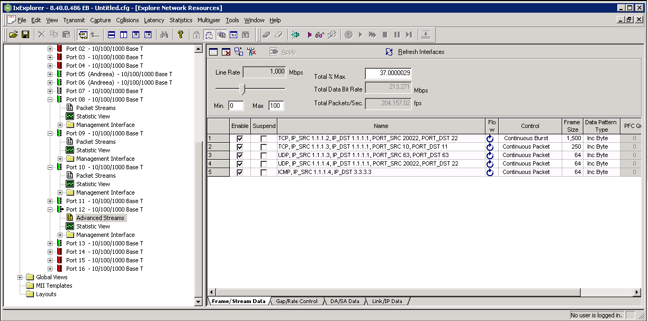

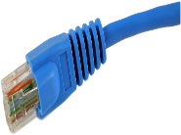
Testing functionality – Acceptance Tests
Testing scripts for each functionality
Packet generators:
IxExplorer
Iperf3
Trafgen
Throughput -> bmon
Jitter -> tcpdump capture
ens9
Port 12

Slide 12
Future improvements
Add latency measurement
Extend functionality to also work for TX side. (currently supported for RX)
Possibility to integrate with SDN Controller (OpenContrail , TungstenFabric)
Improving packet drops and jitter algorithms
Cisco’s NetFlow like functionality

Slide 13
Lessons Learned | Challenges
eBPF has many constraints:
Memory
Number of instructions
Pointer accessing
Loops not supported until kernel version 5.4
Big loops made program exceed permitted number of instructions.
Not so friendly program verifier.
Very difficult to debug.
Poor documentation, small community.

Slide 14

Questions?

